Slide 1
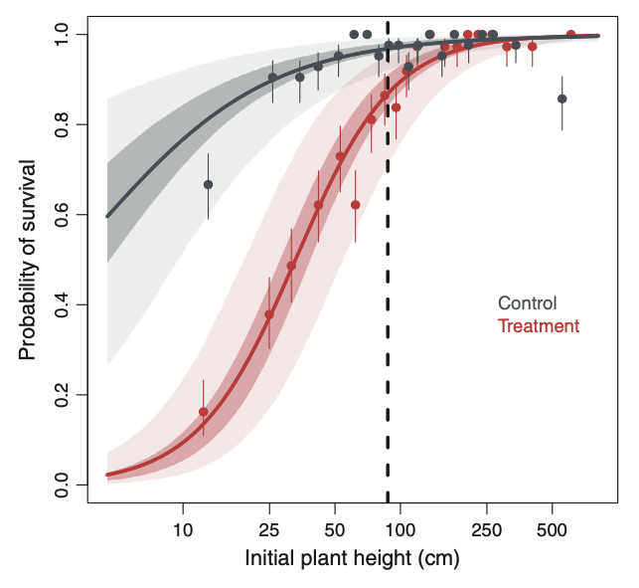
Investigating context dependence
Dr John Dwyer CONS7008

Slide 2
The size and directions of effects often DEPEND on context
Carefully designed studies can capture context dependence
Poorly designed studies often can not…

Slide 3
In experiments…
Full factorial experimental designs
When you have multiple treatments, make sure all treatment combinations are equally represented
If other sources of variation exist, make sure it is spread among all treatment combinations

Slide 4
Full factorial designs
Predictor variable 1
Ambient
Dry
Wet
Ambient + High Nutrients
Dry + High Nutrients
Wet + High Nutrients
High nutrients
Predictor variable 2
Ambient + Low Nutrients
Dry +
Low Nutrients
Wet + Low Nutrients
Low nutrients

Slide 5
Full factorial designs

Slide 6
Full factorial designs
Bench 1
Bench 2
Bench 3
Bench 4
Bench 5
Bench 6

Slide 7
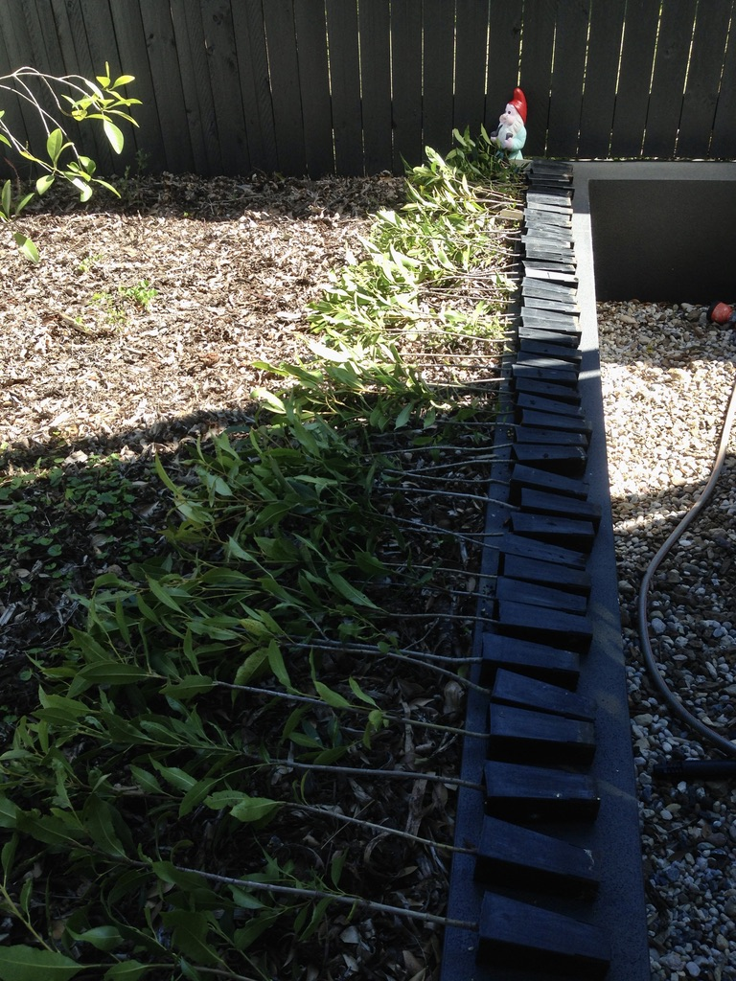
Controlling for other sources of variation

Slide 8
Split plot designs
Plot 1
Plot 2
Plot 3
Predictor 1
Nitrogen addition
Yes
No
Predictor 2
Species
A
B
Plot 4
Plot 5
Plot 6

Slide 9

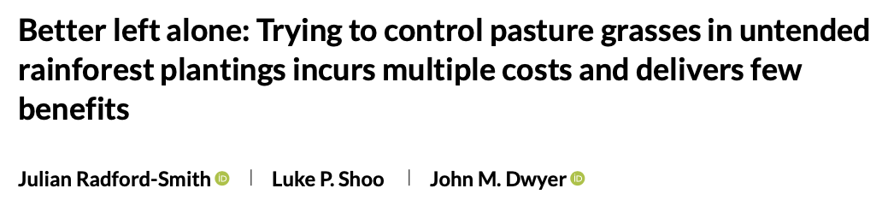
A recent split plot example

Slide 10
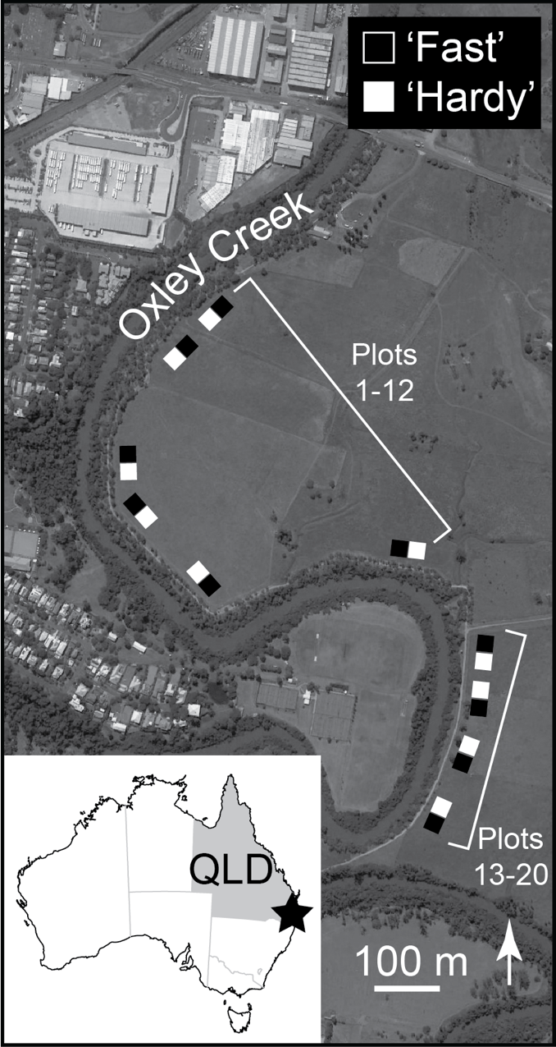
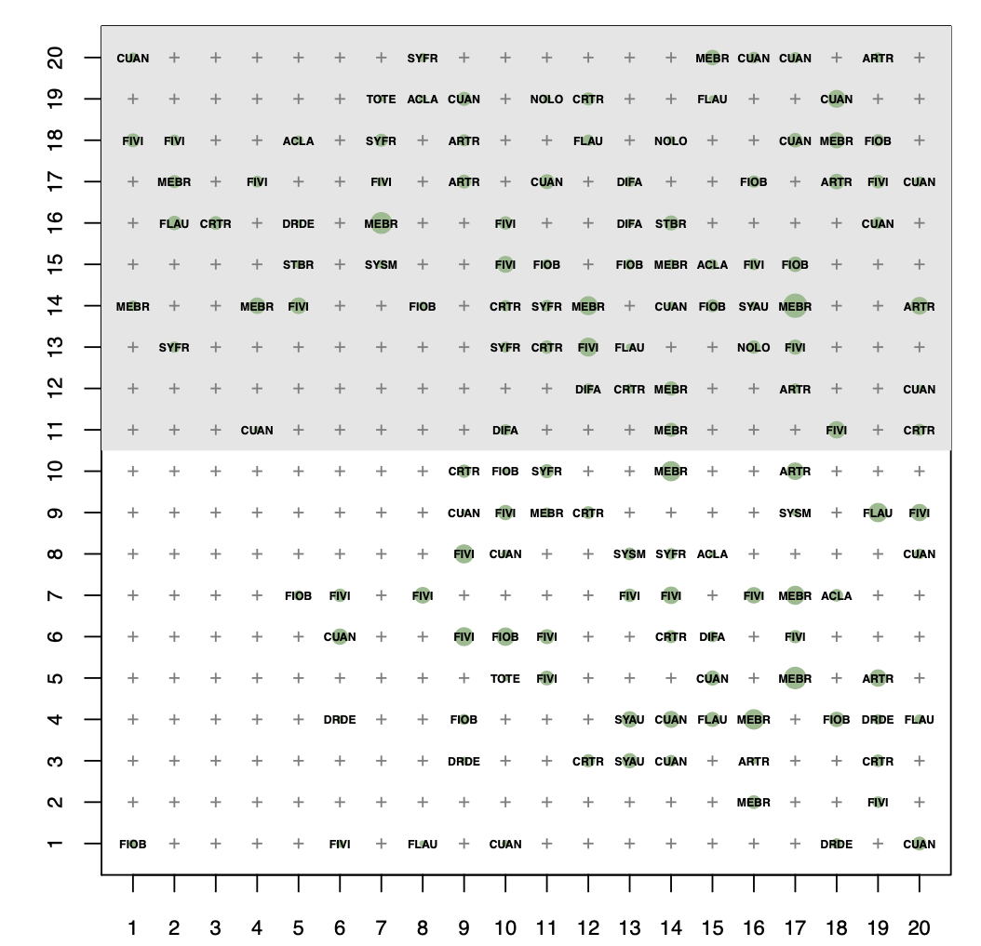
A recent split plot example

Slide 11
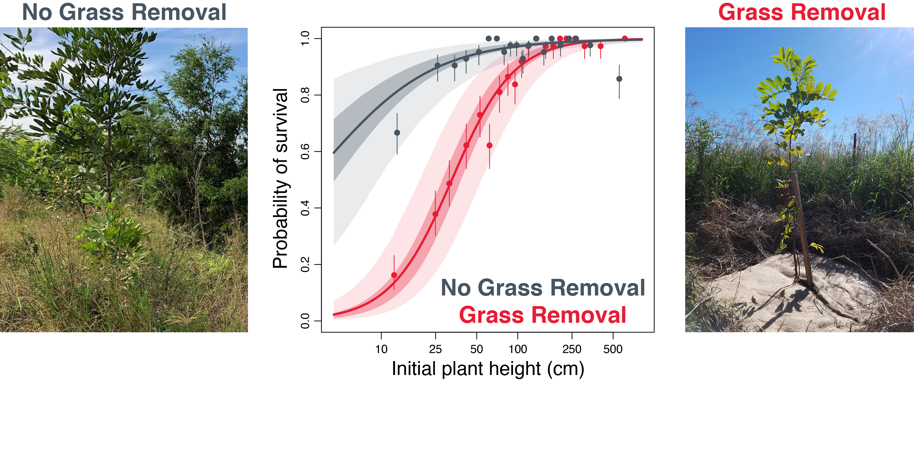
A recent split plot example

Slide 12
A recent split plot example

Slide 13
A recent split plot example
Controlling for other variation!!! (seedling height)

Slide 14
In observational studies
Often aiming to sample populations along multiple gradients of interest
For example:
Rainfall and soil fertility
Forest patch size and distance to other forests
Sedimentation and sea surface temperature

Slide 15
The importance of orthogonality
If our predictor variables are very correlated, then we can’t separate their effects on the response variable!
Orthogonal observational designs minimize correlation among predictors

Slide 16
The importance of orthogonality
For example:
Rainfall and soil fertility:
Capture a range of soil fertilities in dry, average and wet locations
Sedimentation and sea surface temperature
Capture clear and sedimented sites at multiple points along a regional temperature gradient

Slide 17
> with(bird_data, pairs(bird_richness ~ rainfall + shrub_density + patch_size))

Slide 18
> with(bird_data, pairs(bird_richness ~ rainfall + shrub_density + patch_size))
Large Medium Small
bird_richness
rainfall
shrub_density
patch_size

Slide 19
> with(bird_data, pairs(bird_richness ~ rainfall + shrub_density + patch_size))
Large Medium Small
rainfall
shrub_density
shrub_density
patch_size

Slide 20
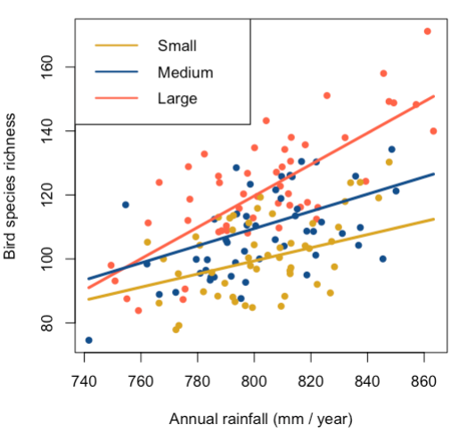
> with(bird_data, pairs(bird_richness ~ rainfall + shrub_density + patch_size))

Slide 21
> with(bird_data, pairs(bird_richness ~ rainfall + shrub_density + patch_size))
Why is this design likely to be difficult to achieve?

Slide 22
Key points
Often the effect of one variable depends on the the value of another variable!
To capture this we can use:
Full factorial experiments
Split plot experiments
Observational studies with orthogonal predictors

Slide 23
Coming up
Thursday 1pm Workshop: Understanding interactions between continuous variables
Thursday 5pm Lecture (Rich Fuller): Socio-economic data I
Pre-recorded stats lecture: Linear models (Multiple regression)
Friday R Prac: Linear models (Multiple regression)

